Slide 1
DevSecOps
Training

Slide 2
Agenda
https://docs.google.com/document/d/1Cydl3Eelcl1fEn4Epo7Ww7MBHmeIU3oC/edit

Slide 3
Training Format
Concepts
Hands-on exercises
Assignments
Interactive

Slide 4
Timing
Start time at 10 am
Break 11.30 am
Lunch 1pm to 2pm
Break 3.40
End at 6 pm

Slide 5
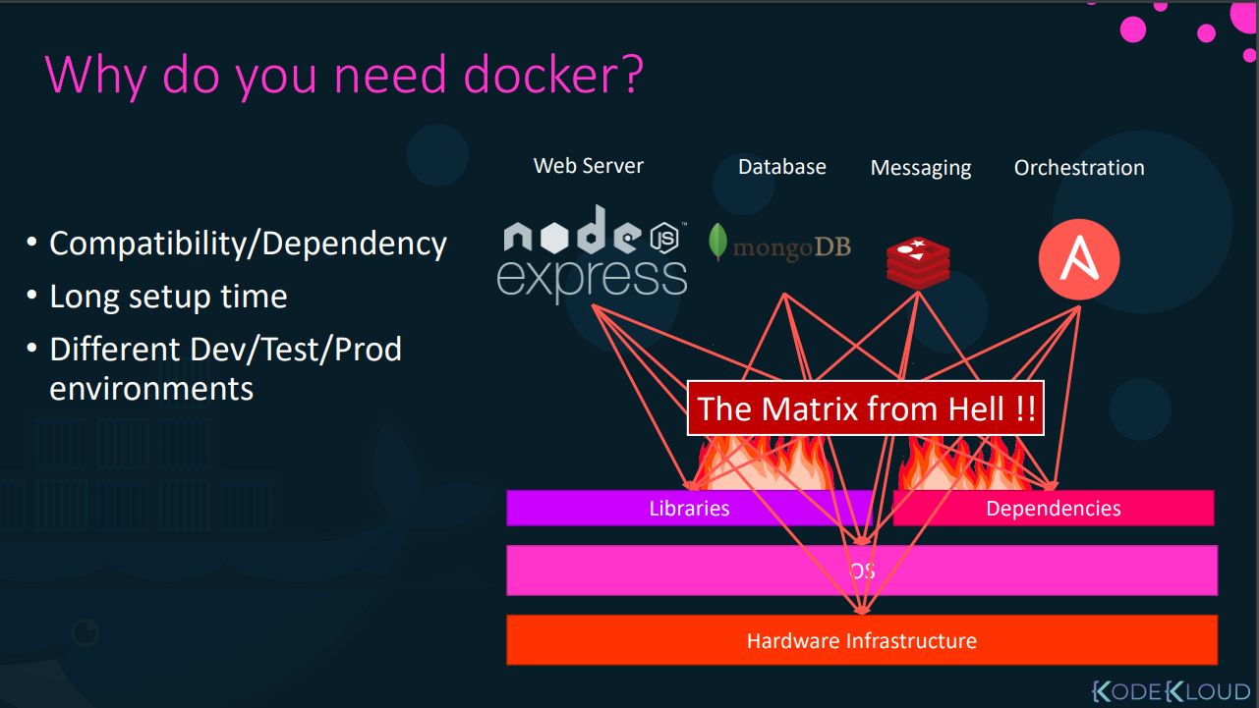

Slide 6
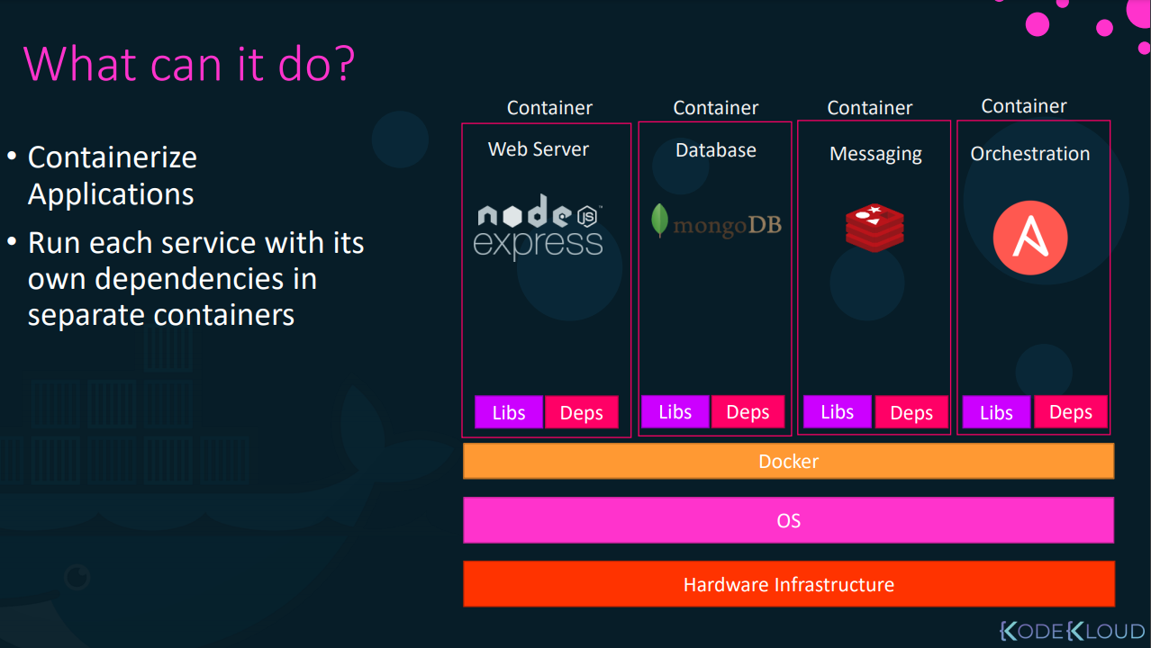

Slide 7
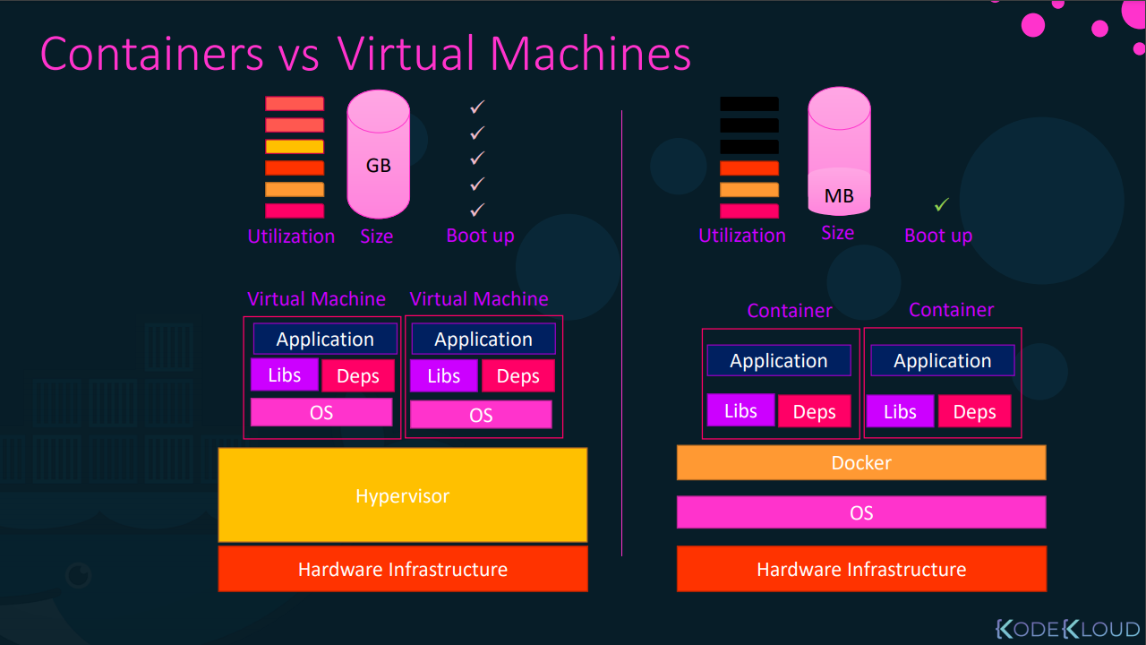

Slide 8
Docker
Docker is an open platform for developing, shipping, and running applications.
Docker enables you to separate your applications from your infrastructure so you can deliver software quickly.
With Docker, you can manage your infrastructure in the same ways you manage your applications.
By taking advantage of Docker’s methodologies for shipping, testing, and deploying code quickly, you can significantly reduce the delay between writing code and running it in production.

Slide 9
Docker
Docker provides the ability to package and run an application in a loosely isolated environment called a container.
The isolation and security allows you to run many containers simultaneously on a given host.
Containers are lightweight and contain everything needed to run the application, so you do not need to rely on what is currently installed on the host.
You can easily share containers while you work, and be sure that everyone you share with gets the same container that works in the same way.

Slide 10
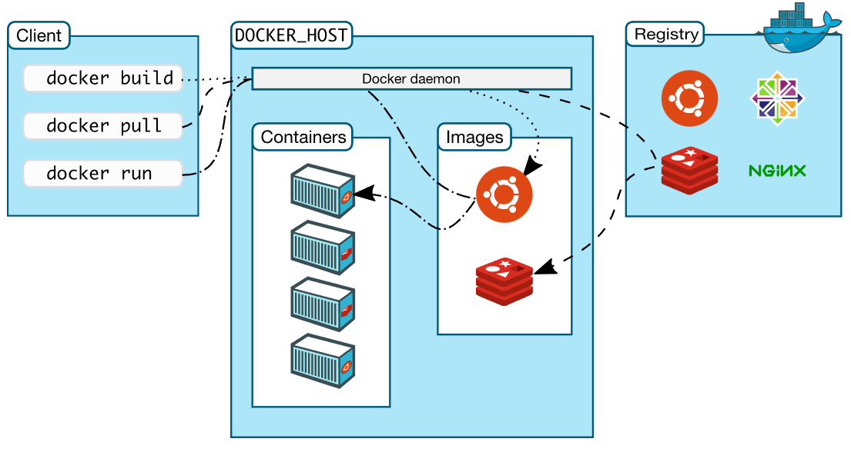
Docker architecture

Slide 11
Docker commands
docker container run --publish 80:80 nginx
docker container run --publish 80:80 --detach nginx
docker container ls
docker container stop
docker container ls
docker container ls -a
docker container run --publish 80:80 --detach --name webhost nginx
docker container run -d -p 3306:3306 --name db -e MYSQL_RANDOM_ROOT_PASSWORD=yes mysql

Slide 12
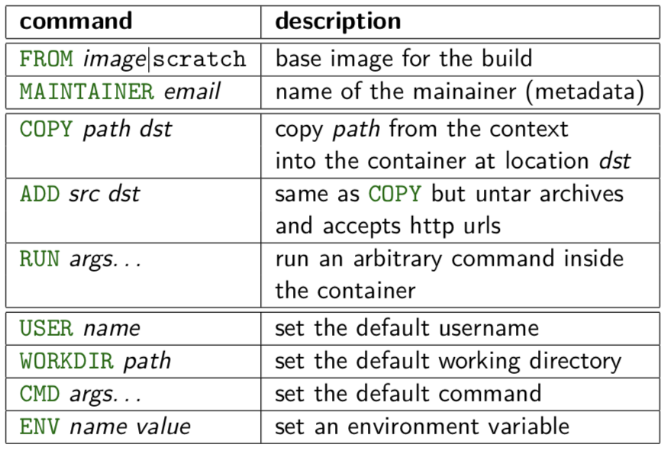
Dockerfile
https://docs.docker.com/engine/reference/builder/

Slide 13
Volumes
By default all files created inside a container are stored on a writable container layer. This means that:
The data doesn’t persist when that container no longer exists, and it can be difficult to get the data out of the container if another process needs it.
A container’s writable layer is tightly coupled to the host machine where the container is running. You can’t easily move the data somewhere else.
Writing into a container’s writable layer requires a storage driver to manage the filesystem. The storage driver provides a union filesystem, using the Linux kernel. This extra abstraction reduces performance as compared to using data volumes, which write directly to the host filesystem.

Slide 14
Container Security Fundamentals
Securing containerized workloads
Understanding container-specific risks
Build-time and runtime security controls
Foundation for Kubernetes security

Slide 15
What is a Container (Security Perspective)
Containers package application and dependencies
Share host OS kernel
Lightweight and fast startup
Weaker isolation than VMs
Security depends on configuration

Slide 16
Containers vs Virtual Machines
VMs provide hardware-level isolation
Containers provide OS-level isolation
Compromised container may impact host
Higher blast radius if misconfigured
Speed vs isolation trade-off

Slide 17
Container Security Shared Responsibility
Cloud provider secures infrastructure
Platform team secures runtime and orchestrator
Developers secure images and dependencies
Most issues originate from images

Slide 18
Container Threat Landscape
Vulnerable base images
Outdated libraries
Running as root
Hardcoded secrets
Supply chain attacks

Slide 19
Container Image Security
Images deployed repeatedly at scale
One insecure image affects all environments
Images are immutable
Scan before deploy

Slide 20
Secure Image Best Practices
Use trusted minimal base images
Pin image versions
Remove unused packages
Run as non-root
Reduce attack surface

Slide 21
Build-Time Container Security
Scan images during CI
Detect CVEs early
Fail builds on critical issues
Prevent insecure images from registry

Slide 22
Runtime Container Security
Zero-day vulnerabilities exist
Runtime behavior monitoring needed
Complements build-time scanning

Slide 23
Runtime Security Controls
Avoid privileged containers
Drop Linux capabilities
Restrict filesystem access
Monitor anomalies

Slide 24
Secrets Management
Never bake secrets into images
Use external secret managers
Inject secrets at runtime
Rotate credentials

Slide 25
Container Registry Security
Use private registries
Restrict push access
Scan registry images
Remove vulnerable images

Slide 26
Container Security in DevSecOps
Security checks at every stage
CI/CD enforces policies
Consistent enforcement across teams

Slide 27
Container Security & Kubernetes
Kubernetes runs containers at scale
Insecure images amplify risk
Container security is prerequisite

Slide 28
Common Mistakes
Trusting public images blindly
Skipping scans
Running as root
No runtime visibility

Slide 29
Exercise Container Scanning
Aqusec or Snyk

Slide 30
Docker Networking Security – Basics
Docker uses network namespaces for container isolation
Each container has its own IP, ports, and interfaces
Default network driver is bridge
Containers can communicate internally by default
Network configuration directly impacts security

Slide 31
Docker Networking – Security Risks
Using default bridge network without isolation
Exposing container ports to 0.0.0.0
Using --network host in production
No network segmentation between services
Unencrypted container-to-container traffic

Slide 32
Docker Networking – Security Best Practices
Use custom bridge networks for isolation
Avoid host networking mode
Expose only required ports and bind to localhost
Segment frontend, backend, and database networks
Monitor and audit container network traffic

Slide 33
Key Takeaways
Containers increase speed and risk
Image security is critical
Shift-left scanning is mandatory
Enables Kubernetes security

Slide 34
Kubernetes
Kubernetes is like linux kernel of distributed systems.
It abstracts away the underlying hardware of the nodes and provides a uniform interface for applications to be both deployed and consume the shared pool of resources.

Slide 35
Architecture Overview
Masters - Acts as the primary control plane for Kubernetes. Masters are responsible at a minimum for running the API Server, scheduler, and cluster controller. They commonly also manage storing cluster state, cloud-provider specific components and other cluster essential services.
Nodes - Are the ‘workers’ of a Kubernetes cluster. They run a minimal agent that manages the node itself, and are tasked with executing workloads as designated by the master.

Slide 36
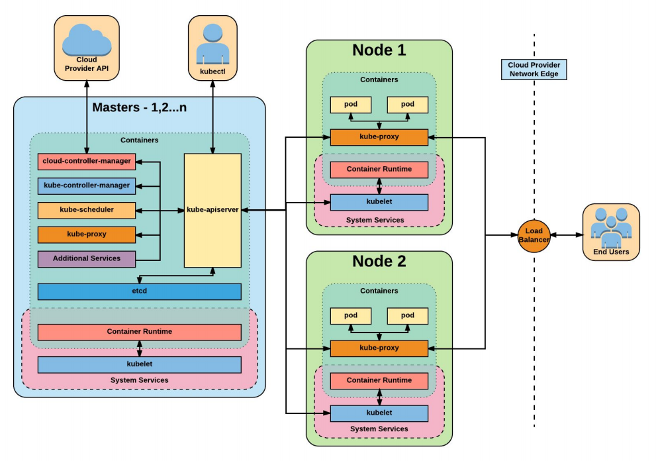

Slide 37
Installation
Install Minikube and Kubectl
https://github.com/arjunachari12/install-jenkins-container/blob/main/kubernetes.md

Slide 38
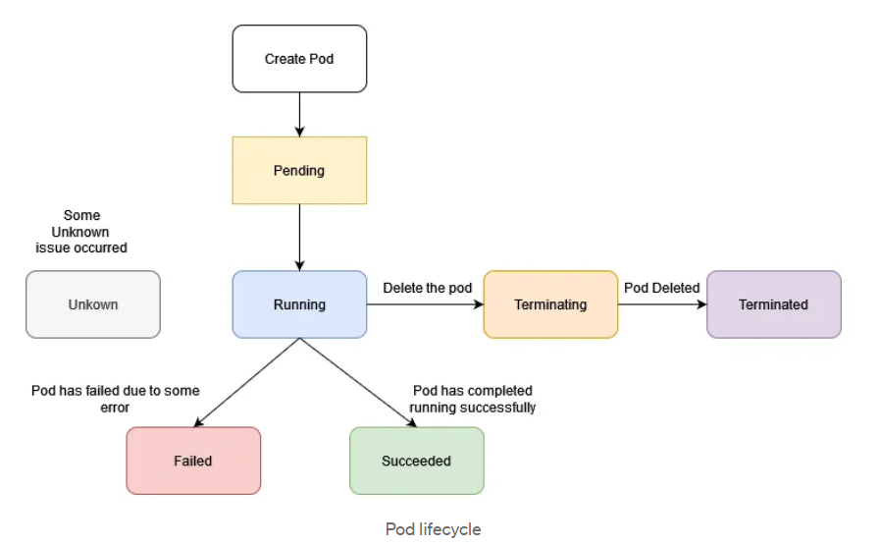
Pods lifecycle

Slide 39
Exercise: Run image as pod
Hands-on steps:
Step 1: Open VS code and create new folder
Step 2 : write manifest file pod.yml, copy code from below link
https://github.com/arjunachari12/k8s-learn/blob/main/pod.yml
Step 3: Execute pod.yml file using below command
kubectl create -f pod.yml
Step 4: You should see pod created message
Step 5: run below commands
kubectl get pod
kubeclt describe pod pod
kubectl delete pod

Slide 40
Assignment: Run multiple images as pod
Hands-on steps:
Step 1: Open VS code and create new folder
Step 2 : write manifest file pod.yml, copy code from below link
https://github.com/arjunachari12/k8s-learn/blob/main/pod2.yml
Step 3: Execute pod.yml file using below command
kubectl create -f pod2.yml
Step 4: You should see pod created message
Step 5: run below commands
kubectl get pod
kubeclt describe pod pod1
kubectl delete pod pod1

Slide 41
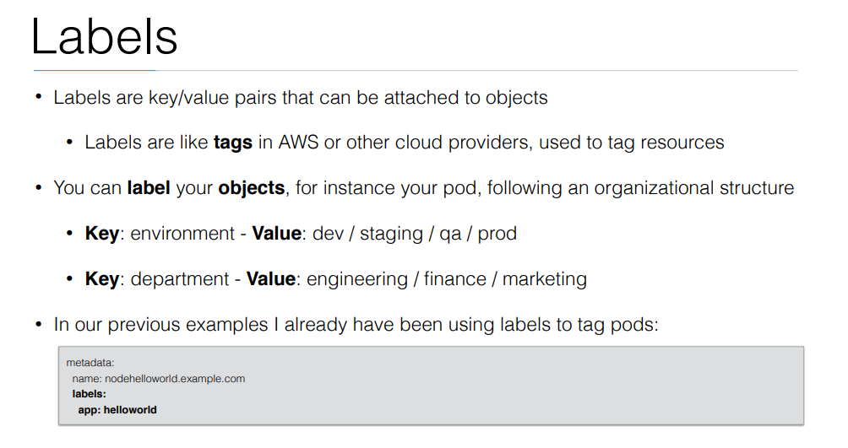

Slide 42
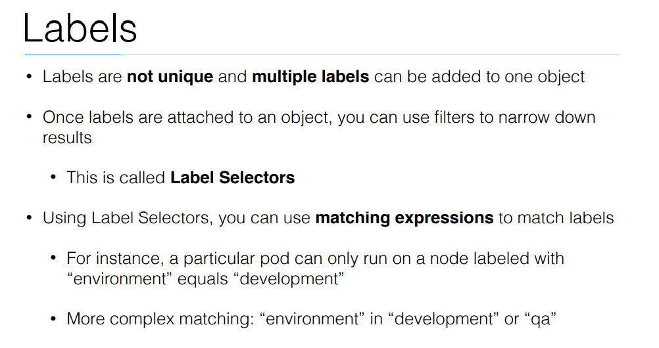

Slide 43
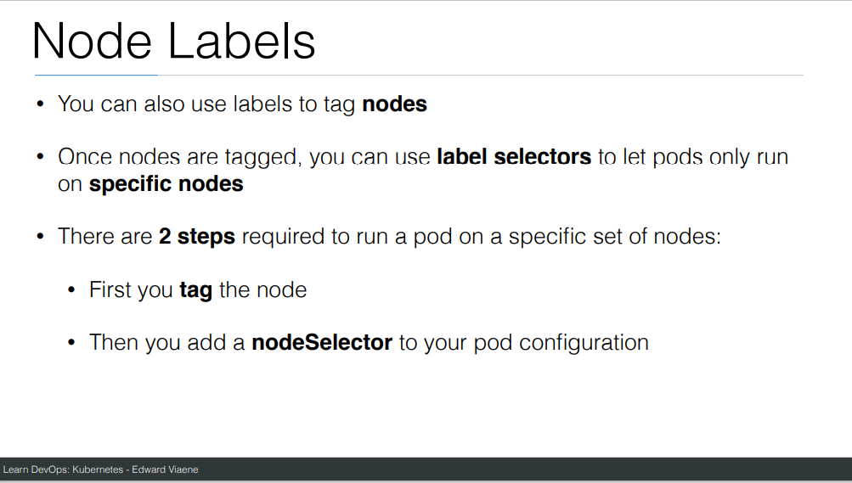

Slide 44
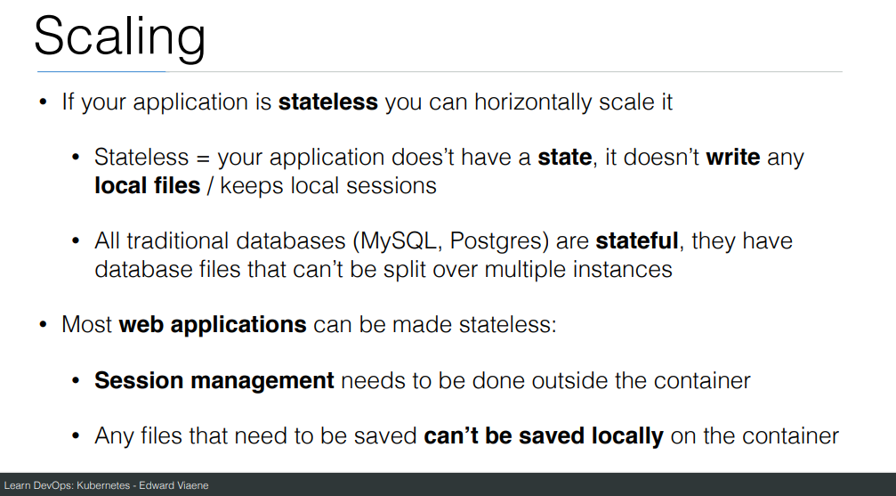

Slide 45
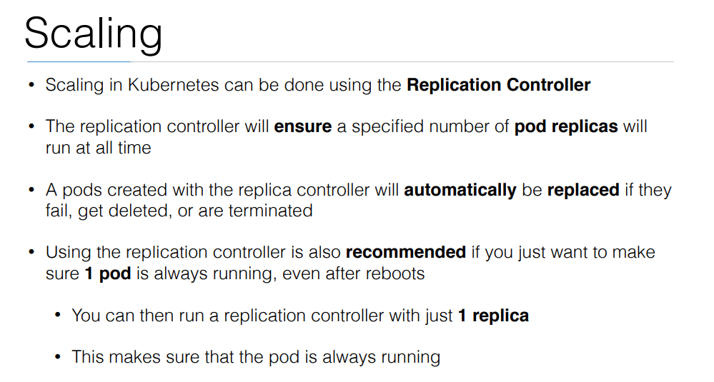

Slide 46
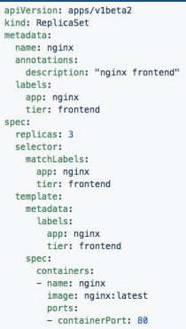
ReplicaSet
Generated ReplicaSet from Deployment spec.

Slide 47
Replicaset
kubectl create -f helloworld_replicaset.yaml
kubectl get rs
kubectl autoscale rs helloworld-controller --max=5
kubectl delete rs helloworld-controller
kubectl edit pods helloworld-controller-9jlsq

Slide 48
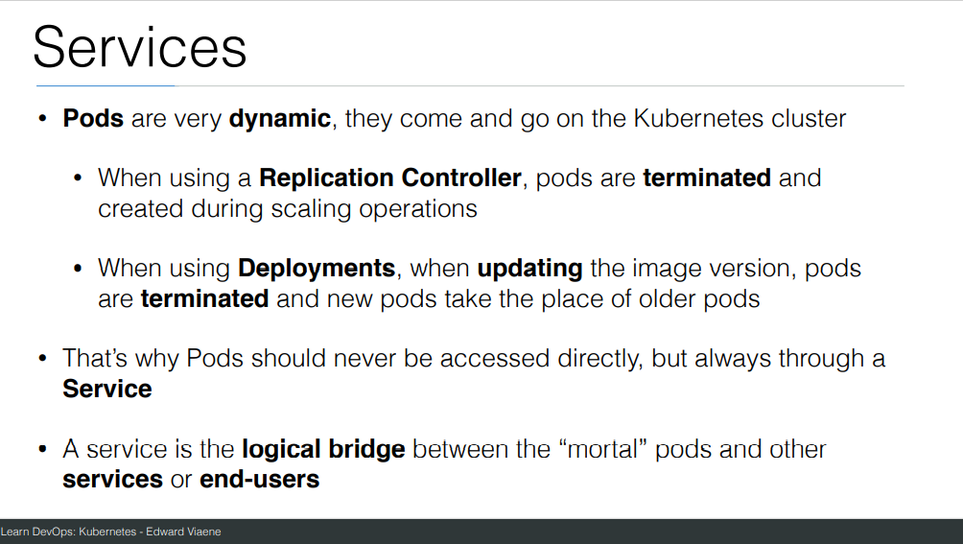

Slide 49
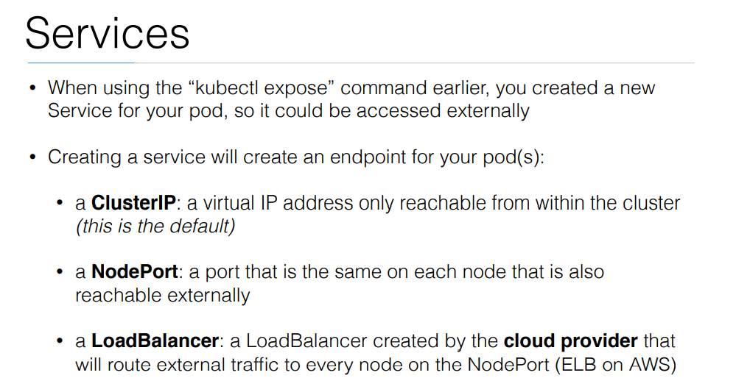

Slide 50
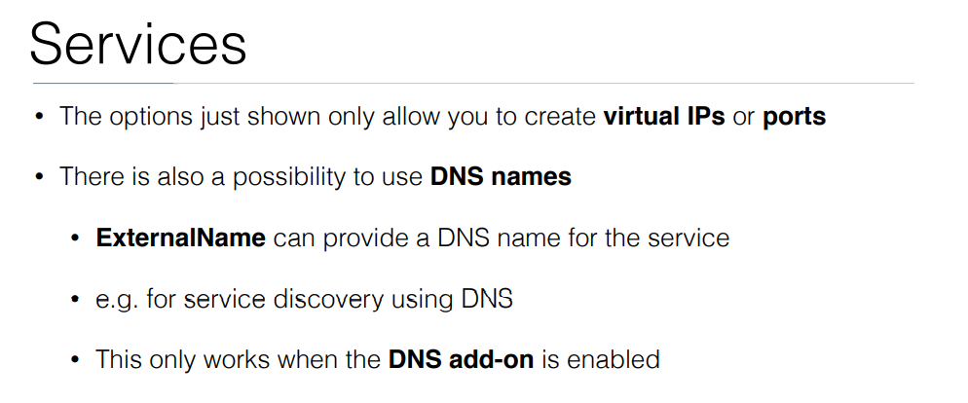

Slide 51
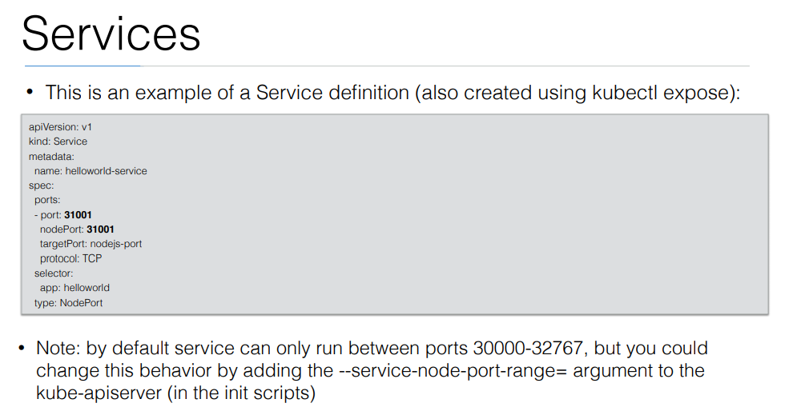

Slide 52
Exercise: Run image as pod
Hands-on steps:
Step 1: Open VS code and create new folder
Step 2 : write manifest file pod3.yml, copy code from below link
https://github.com/arjunachari12/k8s-learn/blob/main/pod3.yml
Step 3: Execute pod.yml file using below command
kubectl create -f pod3.yml
Step 4: You should see pod created message
Step 5: run below commands
kubectl get pod
kubeclt describe pod pod3

Slide 53
Exercise: Expose pod as Service
Hands-on steps:
Step 1: Open VS code and create new folder
Step 2 : write manifest file pod3-service.yml, copy code from below link
https://github.com/arjunachari12/k8s-learn/blob/main/pod3-service.yml
Step 3: Execute pod3-service.yml file using below command
kubectl create -f pod3-service.yml
Step 4: You should see pod created message

Slide 54
Exercise: Expose pod as Service
Hands-on steps:
Step 5: run below commands
kubectl get pod
kubeclt describe pod pod3
kubectl get svc
minikube service helloworld-service --url
kubectl describe svc helloworld-service
kubectl describe svc
Kubectl get svc
kubectl delete svc helloworld-nodeport-service.yml

Slide 55
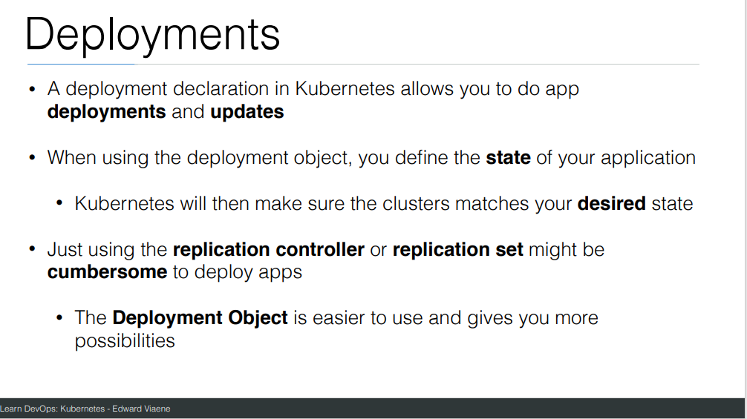

Slide 56
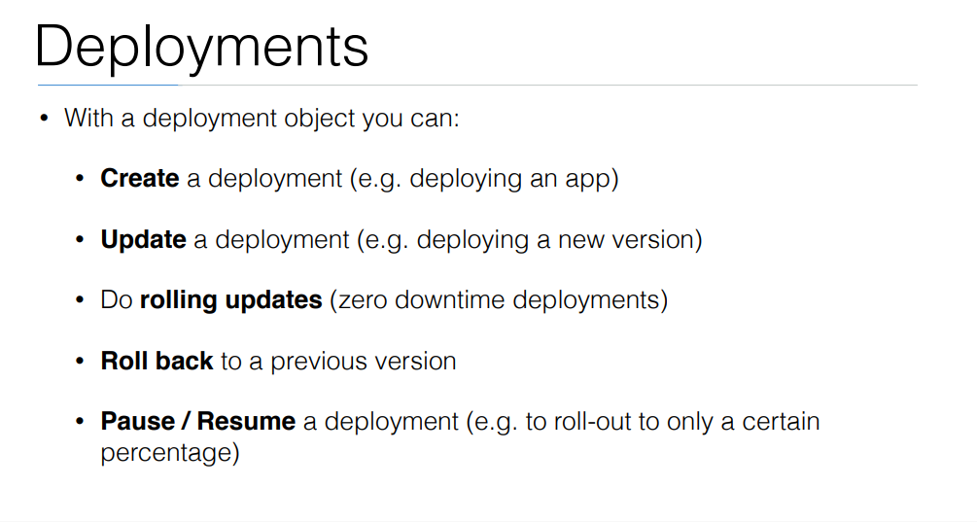

Slide 57
commands
Create a file called helloworld-deployment.yaml
Copy content from https://github.com/arjunachari12/k8s-learn/blob/main/helloworld-deployment.yml
kubectl create -f helloworld-deployment.yaml
kubectl get deployments
kubectl get rs
kubectl get pods
kubectl get pods --show-labels
kubectl rollout status deployment/helloworld-deployment

Slide 58
commands
Created new version of docker image and uploaded in docker hub
kubectl expose deployment helloworld-deployment --type=NodePort
kubectl get svc
minikube service helloworld-deployment --url
Curl url
kubectl set image deployment/helloworld-deployment k8s-demo=arjunachari12/k8s-demo:2
see
Curl to see new version

Slide 59
commands
kubectl get pods
kubectl rollout history deployment/helloworld-deployment
kubectl get pods
kubectl rollout undo deployment/helloworld-deployment
Curl again #modify history count
kubectl edit deployment/helloworld-deployment

Slide 60
Kubernetes Security & DevSecOps Overview
Why Kubernetes security is critical in modern platforms
Dynamic and ephemeral nature increases risk
Security is a shared responsibility
DevSecOps integrates security early
Automation over manual security checks
Security must scale with clusters

Slide 61
Kubernetes Architecture & Trust Boundaries
Control plane manages cluster state
Worker nodes run application workloads
API Server is the main entry point
etcd stores sensitive cluster data
Network paths between components
External integrations increase risk

Slide 62
Kubernetes Threat Model
Compromised container images
Over-privileged RBAC roles
Exposed dashboards and APIs
Container escape vulnerabilities
Supply chain attacks
Misconfigurations

Slide 63
Kubernetes Attack Surface
API server exposure
Container images and registries
Secrets and credentials
Pod-to-pod network traffic
Node OS and kubelet
CI/CD pipeline access

Slide 64
Kubernetes Security Pillars
Cluster hardening
Identity and access management
Network security
Workload protection
Supply chain security
Detection and response

Slide 65
Cluster Hardening Basics
Secure cluster installation
Disable anonymous access
Enable audit logging
Minimal component exposure
Frequent version upgrades
Follow CIS benchmarks

Slide 66
Node Security
Harden node operating systems
Apply regular security patches
Restrict SSH access
Limit node IAM permissions
Protect kubelet API
Use runtime isolation

Slide 67
Control Plane Security
Restrict API server network access
Encrypt etcd communication
Enable TLS for all components
Restrict admin access
Monitor control plane logs
Protect admin credentials

Slide 68
API Server Security
Strong authentication mechanisms
RBAC-based authorization
Admission controllers enabled
Disable insecure ports
API request throttling
Comprehensive audit logs

Slide 69
RBAC Fundamentals
Roles and ClusterRoles
RoleBindings and ClusterRoleBindings
Least privilege principle
Namespace-level isolation
Separate human and service access
Regular permission reviews

Slide 70
Service Accounts & IAM
Avoid default service accounts
Use workload identities
Limit token permissions
Integrate cloud IAM
Rotate credentials
Monitor service account usage

Slide 71
Secrets Management
Kubernetes Secrets are base64 encoded
Enable encryption at rest
Avoid secrets in manifests
Use external secret managers
Restrict secret access
Audit secret usage

Slide 72
etcd Security
Encrypt data stored in etcd
Restrict etcd network exposure
Use mutual TLS
Protect etcd backups
Monitor etcd health
Limit admin access

Slide 73
Kubernetes Network Security
Default flat network model
Use NetworkPolicies
Restrict east-west traffic
Secure ingress access
Control egress traffic
Adopt zero-trust networking

Slide 74
Network Policies
Namespace isolation
Pod selector-based rules
Ingress traffic control
Egress traffic control
Default deny approach
Reduce lateral movement

Slide 75
Service Mesh & Istio – Overview
Service Mesh manages service-to-service communication
Focused on east–west traffic inside Kubernetes
Provides security, traffic control, and observability
Works transparently without application code changes
Uses sidecar proxy pattern with Envoy
Istio is a widely adopted service mesh
Designed for microservices architectures
Complements Kubernetes networking

Slide 76
Istio Architecture & Components
Envoy sidecar injected into application pods
Data plane handles all service traffic
Control plane manages policies and configuration
Istiod issues identities and certificates
Automatic sidecar injection via webhook
Uses Kubernetes service accounts for identity
Centralized policy management
Decentralized traffic enforcement

Slide 77
How Istio Secures Kubernetes Traffic
Mutual TLS for pod-to-pod communication
Automatic certificate issuance and rotation
Strong workload identity per service
Encrypted traffic by default
No trust based on IP addresses
Prevents traffic sniffing
Prevents service impersonation
Implements Zero Trust networking

Slide 78
Istio Authorization & Zero Trust
Identity-based authorization policies
Fine-grained Layer 7 access control
Restrict access by service account
Control HTTP methods and paths
Blocks lateral movement attacks
Default deny with explicit allow
Works independently of NetworkPolicy
Ideal for multi-team clusters

Slide 79
Istio + Kubernetes Security Best Practices
Use NetworkPolicy for baseline L3/L4 security
Use Istio for L7 security and identity
Enable strict mTLS cluster-wide
Apply AuthorizationPolicies consistently
Limit sidecar injection scope
Monitor traffic with Istio telemetry
Combine with RBAC and Pod Security
Adopt defense-in-depth strategy

Slide 80
Pod Security Concepts
Shared node kernel risks
SecurityContext controls
Privileged container risks
HostPath volume exposure
Linux capability management
User and group enforcement

Slide 81
Pod Security Standards
Privileged profile risks
Baseline security controls
Restricted profile best practices
Namespace-based enforcement
Replacement for PSP
Aligns with CIS guidance

Slide 82
Admission Controllers
Intercept API requests
Validate resource security
Mutate insecure configurations
Generate secure defaults
Fail fast on violations
Core DevSecOps control

Slide 83
Policy as Code Overview
Security policies written as code
Version-controlled enforcement
Consistent security rules
Shift-left validation
Automated compliance
Audit-ready governance

Slide 84
Kyverno Policy Engine
Kubernetes-native policy engine
YAML-based policies
Validate, mutate, generate
Background policy scanning
Developer-friendly
Ideal for DevSecOps

Slide 85
Image Security
Use trusted registries
Block latest image tags
Scan images for vulnerabilities
Use minimal base images
Image signing and verification
Prevent image drift

Slide 86
Software Supply Chain Security
Secure CI/CD pipelines
Scan IaC and manifests
Dependency vulnerability scanning
Artifact integrity checks
Signed container images
Pre-deployment policy enforcement

Slide 87
Runtime Security
Monitor container behavior
Detect abnormal activity
Syscall monitoring
Prevent container escapes
Real-time alerts
Automated response actions

Slide 88
Logging & Monitoring
Centralized logging
Kubernetes audit logs
Security event monitoring
Metrics and alerts
Threat detection
Compliance evidence

Slide 89
Incident Response in Kubernetes
Detect security incidents
Isolate affected workloads
Revoke compromised access
Collect forensic data
Patch vulnerabilities
Post-incident analysis

Slide 90
AKS Security Overview
Managed control plane
Azure shared responsibility
Secure-by-default features
Azure security integrations
Built-in governance
Enterprise-ready platform

Slide 91
AKS Identity & Access
Azure AD integration
Managed identities
Kubernetes RBAC with AAD
Least privilege access
Secure admin roles
Identity auditing

Slide 92
AKS Network Security
Private AKS clusters
Azure CNI networking
Network security groups
Application Gateway ingress
Egress traffic control
NetworkPolicy support

Slide 93
AKS Policy & Governance
Azure Policy for AKS
Built-in Kubernetes policies
Compliance dashboards
Audit and deny modes
Policy assignments
Central governance

Slide 94
AKS DevSecOps Pipeline
IaC security scanning
Policy checks in CI
Container image scanning
Admission control enforcement
Continuous compliance
Automated security gates

Slide 95
AKS Security Overview
Azure manages the Kubernetes control plane
Shared Responsibility Model between Azure and customer
Secure-by-default cluster configuration options
Control plane isolated and hardened by Azure
Native integration with Azure security services
Enterprise-ready governance and compliance

Slide 96
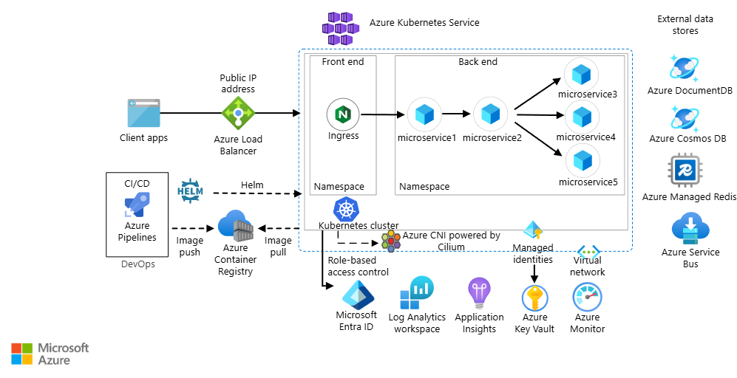
AKS Security Overview

Slide 97
AKS Identity & Access Security
Azure AD integration for cluster authentication
Kubernetes RBAC mapped to Azure AD identities
Managed Identities for workloads and pods
Eliminates static credentials and secrets
Least privilege access enforcement
Audit and sign-in logs via Azure AD

Slide 98
AKS Network, Policy & Governance
Private AKS clusters for API server protection
Azure CNI or Kubenet networking models
Network Security Groups for traffic control
Kubernetes NetworkPolicies for pod isolation
Azure Policy for AKS audit and deny modes
Centralized compliance reporting in Azure

Slide 99
Compliance Frameworks & DevSecOps
Why compliance matters in cloud
Security ≠ Compliance
Regulatory pressure increasing
Shift-left compliance
Automate controls early
Reduce audit friction
Enable faster releases

Slide 100
What Is Compliance?
Mandatory regulatory requirements
Defined by laws & standards
Focus on process & evidence
Audits and attestations
Continuous obligation
Non-compliance risks fines
Applies to people, process, tech

Slide 101
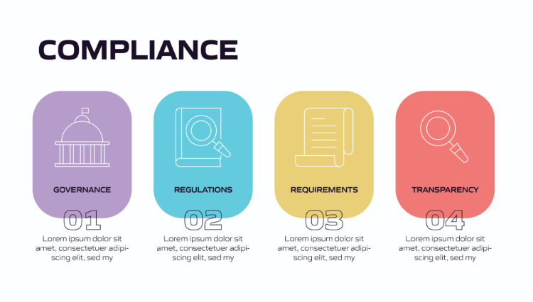
What Is Compliance?

Slide 102
Security vs Compliance
Security protects systems
Compliance proves controls exist
Security is technical
Compliance is evidence-based
Overlap but different goals
Auditors vs attackers
DevSecOps connects both

Slide 103
Key Compliance Frameworks
GDPR – data privacy law
SOC 2 – trust & controls
ISO 27001 – ISMS standard
NIST – security framework
Industry & region driven
Often combined together
Mapped to same controls

Slide 104
GDPR Overview
EU data protection law
Applies globally
Personal data focus
Consent & transparency
Data subject rights
Privacy by design
Heavy penalties

Slide 105
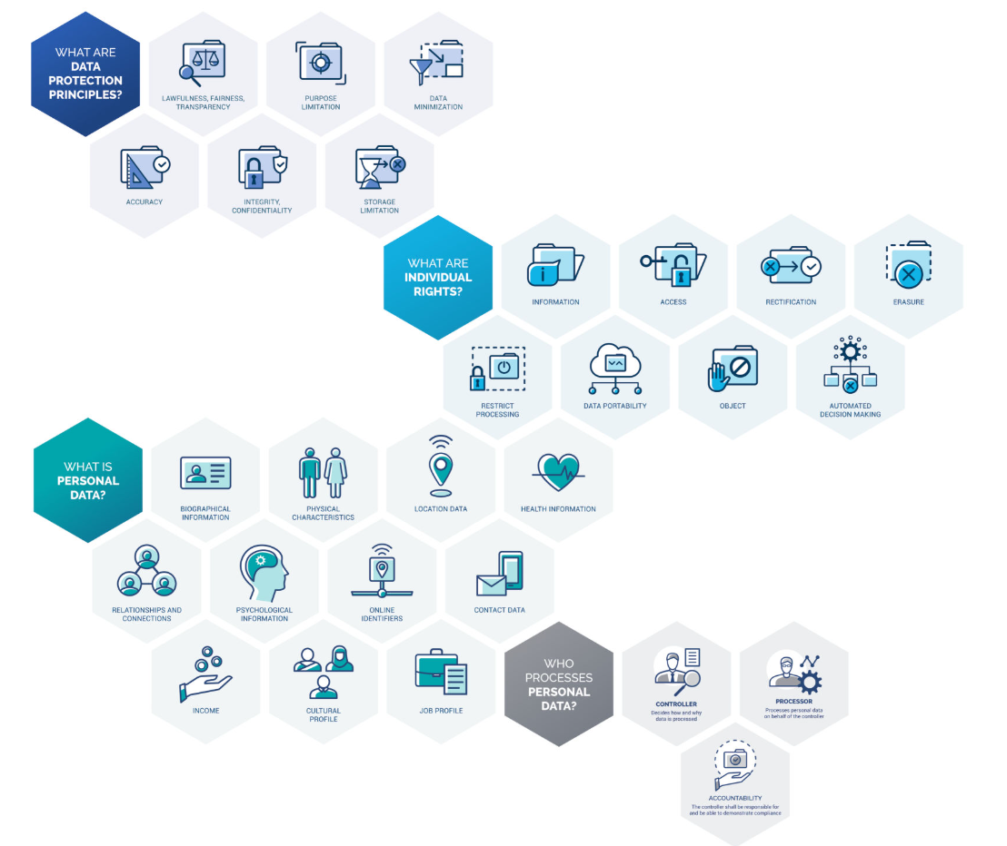
GDPR Overview

Slide 106
GDPR Controls & Case Study
Encrypt data at rest
Encrypt data in transit
Restrict public access
Enable audit logging
Data retention policies
Public data breach example
Pipeline blocks violation

Slide 107
SOC 2 Overview
SaaS & cloud focused
Auditor-driven framework
Trust Service Criteria
Security is mandatory
Type I vs Type II
Operational focus
Customer trust

Slide 108
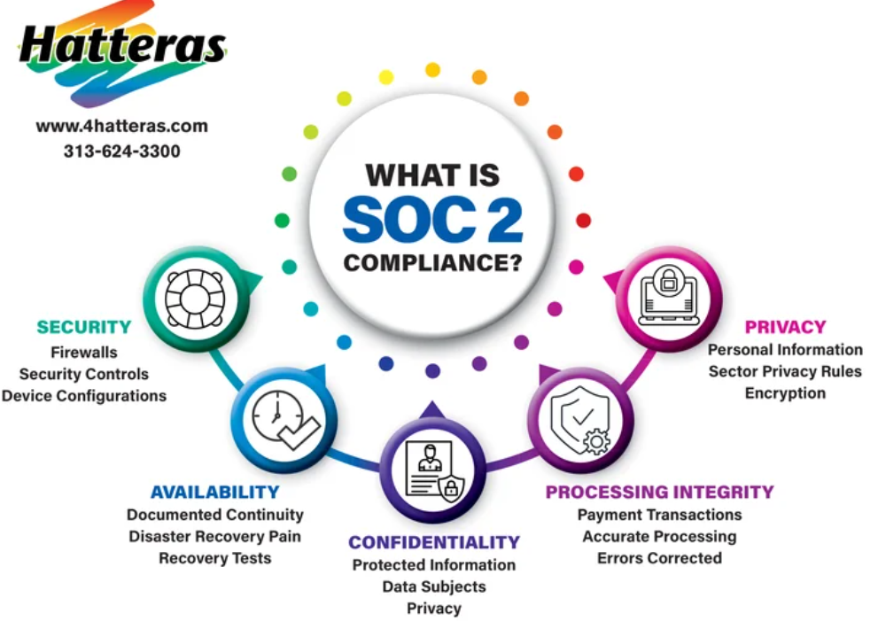

Slide 109
SOC 2 in DevSecOps
PR approval enforcement
Change management via Git
Vulnerability scanning
Access reviews
Logging & monitoring
Incident response drills
Audit evidence automated

Slide 110
ISO 27001 Overview
International ISMS standard
Risk-based approach
Management responsibility
Continuous improvement
People, process, tech
Certification based
Annex A controls

Slide 111
ISO 27001 & DevSecOps
Asset inventory via IaC
Risk treatment automation
Secure SDLC
Policy enforcement
Monitoring & logging
Internal audits
Continuous compliance

Slide 112
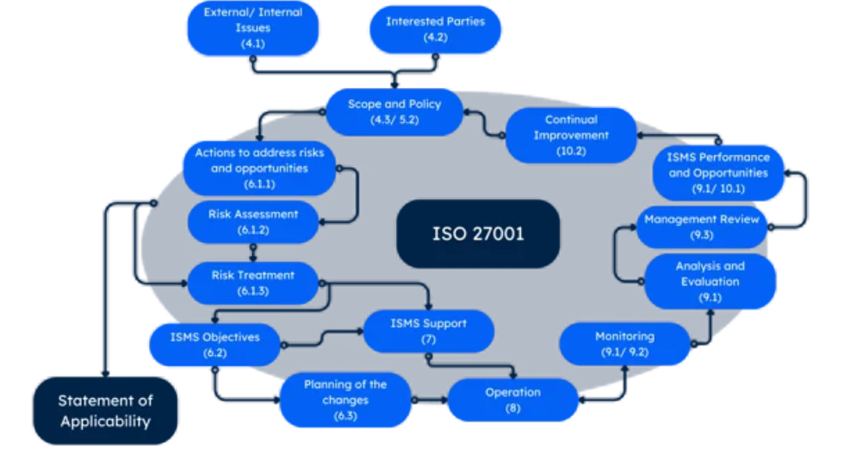
ISO 27001 Overview

Slide 113
NIST Overview
Best-practice framework
Widely adopted
No certification
Technical depth
Risk-based controls
Cloud friendly
Foundation for others

Slide 114
Framework Mapping
GDPR covers privacy
SOC 2 covers operations
ISO covers governance
NIST covers technical
Same controls reused
Single pipeline
Unified compliance

Slide 115
Compliance-Driven Pipeline Gating
Automated policy checks
Fail fast approach
No manual bypass
Pre-production enforcement
Security as code
Audit-ready pipelines
Consistent controls

Slide 116
DevSecOps Tools for Compliance
Terraform & Bicep
OPA & Conftest
Checkov for IaC
Trivy & Snyk
Azure Policy
Defender for Cloud
CI/CD integration

Slide 117
Key Takeaways
Compliance must be automated
Manual audits don’t scale
DevSecOps enables compliance
One pipeline many frameworks
Policies enforce controls
Tools provide evidence
Compliance becomes boring

